Slide 1
CS 7172 Parallel and Distributed Computation Centralized Structure
Kun Suo
Computer Science, Kennesaw State University
https://kevinsuo.github.io/

Slide 2
Outline
What is centralized structure?
Examples:
Google borg
Kubernetes
Mesos

Slide 3
Cloud
Cloud computing is the on-demand availability of computer system resources, especially data storage and computing power, without direct active management by the user.
Today, almost every services are built on the cloud
Video
Social network
News
Entertainment
…

Slide 4
Scale of the Cloud
How to manage millions of servers?

Slide 5
How to manage millions of servers?
In many scenarios, our requests are aggregated on one server, and this server coordinates the relationship between our requests and other servers.
The way that one server manages other servers in a unified manner is a centralized structure in a distributed architecture

Slide 6
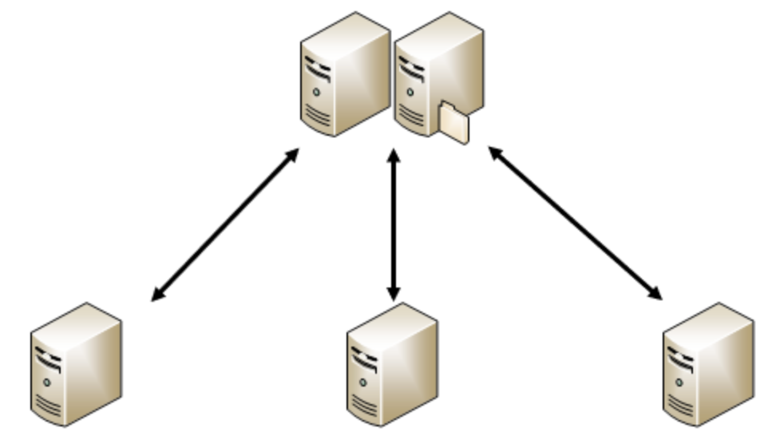
What is Centralized Structure?
The central server is composed of one or more servers.
All data in the system are stored in the central server, and all business in the system is processed by the central server first. The central server performs resource and task scheduling.
Multiple node servers are connected to the central server and report their information to the central server. The central server sends tasks to the node server based on the information; the node server executes the tasks and sends the results & feedback to the central server.
Central server
Node servers

Slide 7
What is Centralized Structure?
Advantages:
Simple structure
Centralized manage and scheduling, the node servers do not need to communicate with each other and only need to communicate with the central node
Central server
Node servers

Slide 8
Example 1 of Centralized Structure: Google Borg
Borg is a cluster management system used internally by Google. It adopts a typical centralized structure and is responsible for submitting, scheduling, starting, restarting, and managing all applications running in Google.
In Borg, a cluster is called a cell, and each cell has a central server called BorgMaster; other servers are node servers or slave servers called Borglet

Slide 9
Example 1 of Centralized Structure: Google Borg
BorgMaster contains two processes:
Borgmaster main process:
Handle RPCs from clients, e.g., query, update, etc.
Manage all entity states and communicate with Borglet
Scheduler process:
Responsible for scheduling, e.g., find a node server for one task execution

Slide 10
Example 1 of Centralized Structure: Google Borg
Borglet, agent on each node server:
Responsible for task start, stop, reboot, etc.
Manage the server on local node server
Send task status, server status, etc. to the BorgMaster

Slide 11
Example 1 of Centralized Structure: Google Borg
Tasks on Borg
Batch jobs: take several seconds to several days to complete. These jobs are not sensitive to latency and short-term performance fluctuations
Long jobs: running forever and is responsible for handling short, latency-sensitive requests (ranging from microseconds to hundreds of milliseconds)

Slide 12
Example 1 of Centralized Structure: Google Borg
Advantages of Borg
Developers only need to focus on the application, not on the underlying resource management. It hides resource details and users can focus on developing applications.
High reliability and availability to support millions of applications.
Support the management and operation of thousands of servers.

Slide 13
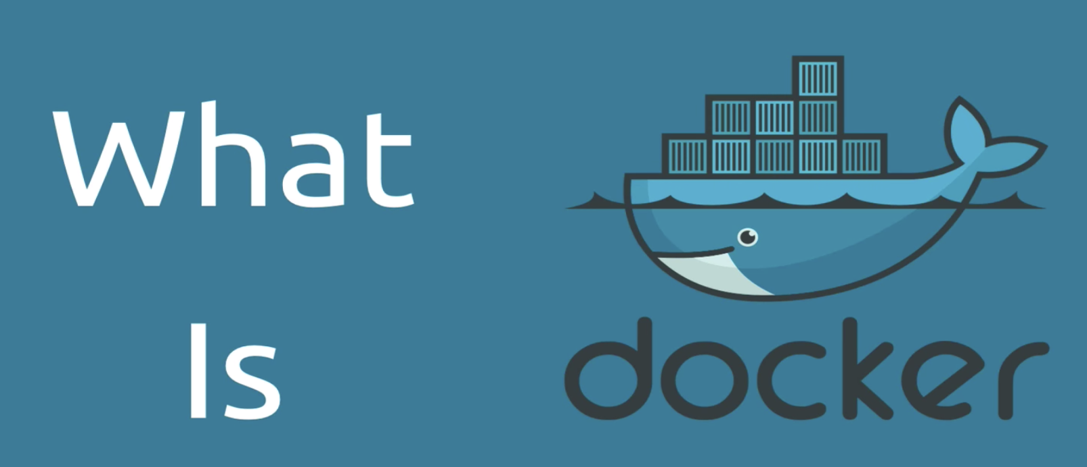
What is Docker container?
https://www.youtube.com/watch?v=RyxXe5mbzlU

Slide 14
Example 2 of Centralized Structure: Kubernetes
Kubernetes is Google's open source container cluster management system
Kubernetes supports running containerized applications on the nodes of the cluster, which can automate container operations, such as deployment, scheduling, and elastic scaling between nodes, etc.
https://kubernetes.io/

Slide 15
Example 2 of Centralized Structure: Kubernetes
Kubernetes is a typical centralized structure.
A Kubernetes cluster is composed of Master nodes and Worker nodes, as well as the client command line tool kubectl and other additional items.

Slide 16
Example 2 of Centralized Structure: Kubernetes
Master node:
It runs on a central server.
The master node is composed of API Server, Scheduler, Cluster State Store, and Control Manger Server
Master node is responsible for scheduling and management of the cluster.

Slide 17
Example 2 of Centralized Structure: Kubernetes
Master node:
API Server: entrance to all commands and is responsible for processing operations and executing related business logic
Scheduler: based on the resources required by the container and the resource information of the node server, it automatically select the appropriate node server for the container
Cluster State Store: it uses etcd by default. Etcd is a distributed key-value store that is mainly used for shared configuration and service discovery.
Control Manager: used to perform most of the cluster-level functions, such as lifecycle functions (event garbage collection, etc.) and API business logic.

Slide 18
Example 2 of Centralized Structure: Kubernetes
Worker node:
runs on the node server, including kubelet and kube-proxy core components
is responsible for running the application container.

Slide 19
Example 2 of Centralized Structure: Kubernetes
Worker node:
kubelet: used to interact with the API Server through the command line, and operate the Worker node according to the received request. By communicating with the API server, it receives requests or command from the Master node and control the containers on the Worker node (for example, restarting the failed container).
kube-proxy: responsible for creating a network proxy and load balancing service for the container.

Slide 20
Example 2 of Centralized Structure: Kubernetes
Worker node:
Kube DNS: is responsible for providing DNS services for the entire cluster
CNI is a standard universal interface for the Container Network Interface, which is used for container management systems and network plug-ins.

Slide 21
Example 2 of Centralized Structure: Kubernetes
Advantages:
Automate container deployment and replication
Organize containers into groups (pods)
Load balancing among containers
Easy version control and rolling updates

Slide 22
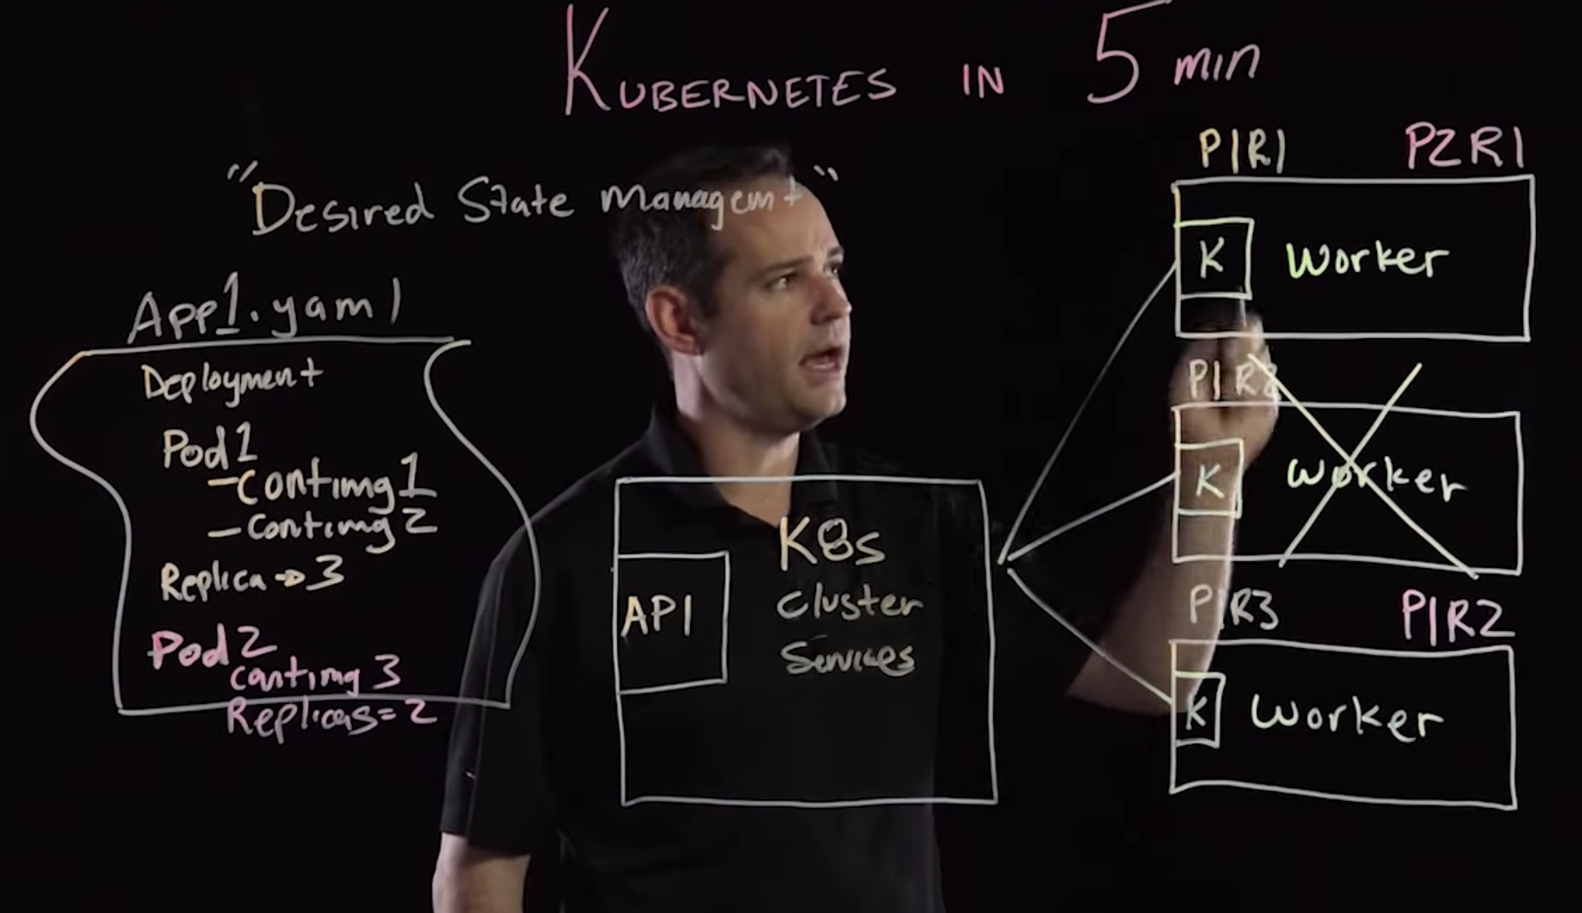
Example 2 of Centralized Structure: Kubernetes
https://youtu.be/PH-2FfFD2PU

Slide 23

Example 3 of Centralized Structure: Mesos
Open source distributed resource management framework by Apache
Mesos is in centralized structure
http://mesos.apache.org/

Slide 24
Example 3 of Centralized Structure: Mesos
Difference between Borg and Mesos
Borg's Master directly interfaces with user applications, which means that users can directly send tasks to Borg's Master
Mesos is only responsible for the management and allocation of the underlying resources and does not involve functions such as storage and task scheduling. Therefore, Mesos Master interfaces with frameworks such as Spark, Hadoop, and Marathon. User tasks need to be submitted to these frameworks.

Slide 25
Example 3 of Centralized Structure: Mesos
In Mesos, a cluster includes a Mesos Master and multiple Mesos Agents.
Mesos Master runs on the central server, and Mesos Agent runs on the node server.

Slide 26
Example 3 of Centralized Structure: Mesos
The Mesos Master:
Responsible for collecting and managing the resources and status of the server where the Agent is located
Interface with frameworks such as Spark and Hadoop and notify these frameworks of the resource information of the servers in the cluster for task resource matching and scheduling.
Mesos Master usually uses one master and two backup standbys for fault handling and recovery.

Slide 27
Example 3 of Centralized Structure: Mesos
The Mesos Agent:
Responsible for starting, stopping, and restarting tasks
Responsible for collecting information and status of the server's resources (such as CPU, memory, etc.) and reporting it to the Mesos Master.

Slide 28
Example 3 of Centralized Structure: Mesos
Advantages of the Mesos: Effectiveness
Mesos abstracts physical resources, allocates resources at the application layer instead of the physical layer, and allocates tasks through containers.
The application's scheduler (e.g., Hadoop) knows how to make the most efficient use of resources, therefore, allocating resources at the application layer can benefit the special needs of each application.
Allocating tasks through containers is more lightweight and benefits from migration

Slide 29
Example 3 of Centralized Structure: Mesos
Advantages of the Mesos: Scalability
Two-level scheduling architecture: Mesos Master allocates resources and corresponding Framework schedules tasks.
Since the Master does not have to know the complex logic behind each type of application and does not have to schedule each task, it can be implemented with very lightweight code and it is easier to expand the cluster size.

Slide 30
Example 3 of Centralized Structure: Mesos
Advantages of the Mesos: Modular
Each time a new framework (e.g., Hadoop, spark, etc.) is added, the Master does not need to add new code, and the Agent module can be reused.
Developers can focus on the choice of applications and frameworks. This allows Mesos to support multiple frameworks and adapt to different application scenarios.

Slide 31
Comparison
 | Borg | Kubernetes | Mesos
Information | Close source, used by Google inside | Open source | Open source
Design purpose | Allow user focusing on applications instead of resource management | Provide support to large scale of container management | Provide dynamic resource allocation for data center users
Architecture | Master/Slave | Master/Slave | Master/Slave
Scheduling | Single layer scheduling | Single layer scheduling | Two-layer scheduling
Interface to outside | End user task | End user task | Framework (e.g., Hadoop)
Scheduling unit | Job | Pod (group of containers) | Container and job
Operating unit | Task | Service | Task
User representative | Google | Google, Amazon, Microsoft, … | Twitter, Apple, …

